Slide 1
Adverse Drug Reactions

Slide 2
Definition
According to WHO:
ADRs can be defined as Any response to a drug which is noxious and unintended and which occurs at doses normally used in Man for prophylaxis, diagnosis or therapy

Slide 3
Incidence Of ADRs
It is very difficult to be certain how commonly ADRs occur
The following are representative figures:
Hospital in-patients: 10-20% suffer ADRs
Death in Hospital in-patients: 0.24-2.9% are due to ADRs
Hospital admission: 0.3-5% of hospital admission are due to ADRs
Therefore, ADRs are a considerable problem

Slide 4
Classification
ADRs can be classified initially as either Type A or Type B
Classification can be extended by adding
Type C (chronic long term effects)
Type D (delayed effects) and
Type E (end of use or withdrawal effect)
Type F( failure of therapy)

Slide 5
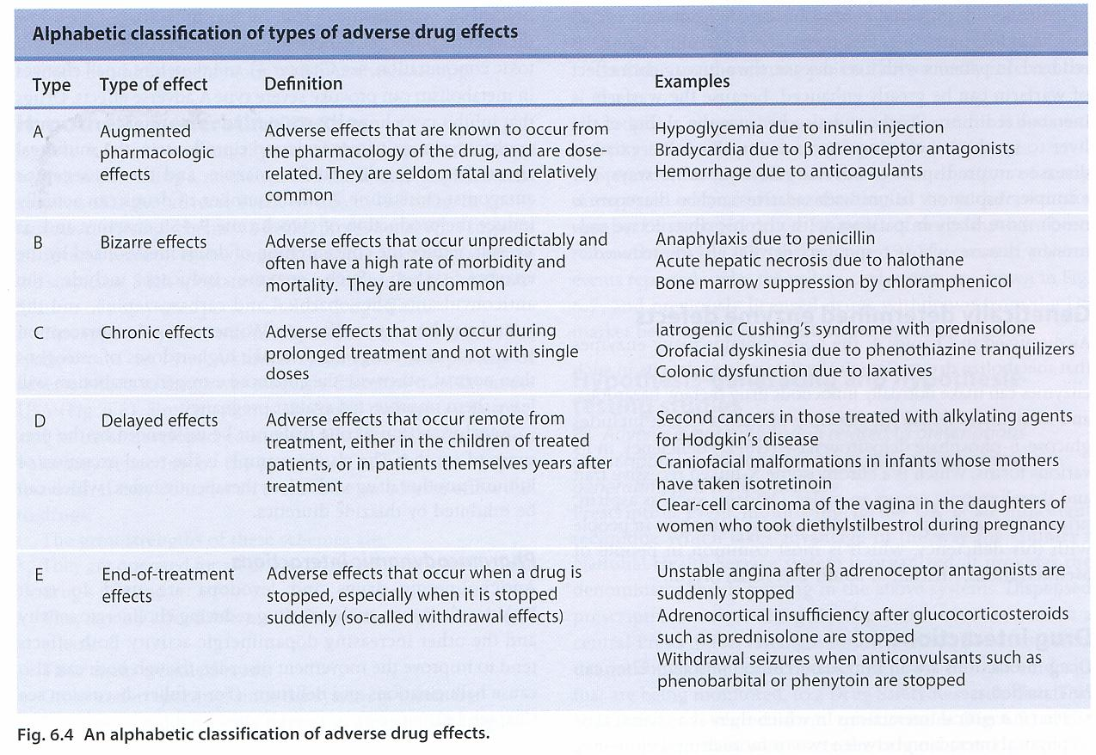

Slide 6
Type A (augmented) reactions:
are normal pharmacological effects which are undesirable.
Are usually dose-dependent and fairly predictable
Are an important cause of morbidity but death is unusual

Slide 7
Examples for Type A
Haemrorhage with Anticoagulants (Heparin & Warfarin)
Hypoglycemia with (insulin, sulfonylurea)
Bradycardia with beta adrenoreceptor blocker

Slide 8
Type B ( bizzare) reactions
Are effects unrelated to the pharmacological effect of drug
Are rare, unpredictble
Generally unrelated to dose
Are often severe or fatal

Slide 9
Examples for Type B
Malignant hyperthermia of anesthesia
Immunological reactions

Slide 10
Predisposing Factors
1- Multiple drug therapy:
Likely due to synergistic effect but keep in mind (multiple disease states)
2- Age
The old and the very young are more susceptible….WHY??
3-Gender: women generally at great risk of ADRs than men

Slide 11
Predisposing Factors
4- Intercurrent disease including patients with renal or hepatic failure and HIV-positive patients
5- Race and genetic polymorphism
Pharmacogenetics: deals with variations in drug response that are hereditary control
Genetic variation in genes for drug metabolizing enzymes (polymorphism in cytochrome P450) , drug receptor, transporter

Slide 12
Dose-relared ADRs
Can occur due to:
Pharmaceutical variations
Pharmacokinetic variations
Pharmacodynamic variations

Slide 13
A-1- Pharmaceutical variations
Occurs due to alterations in the quantity of drug present or in its release charactersistics
In 1983, a rate-controlled preparation of indomethacin was withdrawn following the receipt of significant number of reports of GIT bleeding and hemorrhage

Slide 14
A-2-Pharmacokinetic variations
Quantitative alterations in the absorption, distribution , metabolism and elimination may lead to alterations of drug at site of action with corresponding changes in its pharmacological effects

Slide 15
Absorption
Factors can influence absorption:
Dosage and pharmaceutical factors
GIT motility
Absorptive capacity of GI mucosa
First pass metabolism
Rate of Gastric emptying

Slide 16
Distribution
Regional blood flow
Plasma protein and tissue binding
Elimination
Reduced elimination leads to drug accumulation, potential toxicity due to increased plasma and tissue levels

Slide 17
Renal excretion
Impaired glomerular filteration such as patients with intrinsic renal disease , eldery and neonates
Potential toxic drugs in this respect are digoxin, ACE inhibitors and aminoglycosides
Occurrence of these ADR may be minimized by adjusting dosage given to individual patients on the bases of their renal function

Slide 18
Drug metabolism
Phase I ( oxidation, reduction or hydrolysis)
Phase II ( sulphation, glucuroniation, acetylation or methylation
Genetic or environmental influences applies for oxidation, hydrolysis and acetylation
Competition for glucuronidation may occur when 2 drugs metabolized by this pathway

Slide 19
Microsomal oxidation
Drug metabolism occurs mainly in ER of liver by Cytochrome P450 enzyme
Individuals with impaired and normal oxidation are classified as poor and rapid metabolizers

Slide 20
Example: deprisoquine metabolism
Poor metabolizers tend to have reduced first pass metabolism, increased plasma levels and exaggerated pharmacological response to deprisoquine, resulting in postural hypotension. By contrast rapid metabolizers may require higher doses for a standard effect

Slide 21
hydrolysis
Normally succinylcholine is metabolized in plasma by non-specific esterase called pseudocholinesterase
Normally this metabolism is fast
However in some individuals, the pseudocholinesterase is abnormal and does not metabolize the succinylcholine so rapidly
So, the drug persist in the blood and continues to produce neuromuscular blocking for several hours.

Slide 22
This result in respiratory paralysis (Scoline apnoea)
Requires prolonged ventillation until it is cleared from the blood
This abnormality is inherited in an autosomal recessive fashion

Slide 23
Acetylation
Several drugs are acetylated by the hepatic cytosolic isoform NAT2 of the enzyme N-acetyltransferase
Drugs whose acetylation is genetically determined in this way are, isoniazide, hydralazine, procainamide, dapsone, and some sulfonamides.

Slide 24
The clinical consequence of these differences are that in slow acetylators there may be enhanced response to ttt but also an increased risk of drug toxicity.

Slide 25
Thus, slow acetylators are reported to require lower doses of INH and hydralazine than fast acetylators in ttt of TB and hypertension, respectively

Slide 26
The acetylator status of an individual can be determined by giving a sulfonamide orally and measuring the relative proportions of acetylated and total sulfonamide in a sample of urine passed 5-6 h later.

Slide 27
Glucuronidation
Some drugs (e.g morphine, paracetamol and ethinylestradiol) are eliminated by glucuronide conjucates.
Glucuronyltransferases are inducible and administration of inducing drug can lead to loss of efficacy

Slide 28
Mechanisms of type B ADRs
Pharmaceutical causes
Pharmacokinetic causes
Pharmacodynamic causes

Slide 29
Pharmaceutical Causes
Presence of degradation products of active constituents
Non-drug components (excepients, colouring agents, preservatives…etc)
Example: in 1937: USA
105 lethal cases diethylenglycol was used to solubilize sulphanilamides

Slide 30
Pharmacokinetic causes
No documented type B adverse reactions that can be attributed to abnormalities of absorption or distribution
Mostly , bioactivation of drugs to yield reactive species is responsible for type B ADRs. Bioactive metabolite lead to direct or immune-mediated toxicity
Examples : Halothane( hepatotoxicity)
Carbamazepine ( Hypersensitivity Rx)
Clozapine( agranulocytosis)

Slide 31
Pharmacodynamic Genetic Variations
Some individuals have biochemical or physiological abnormalities that make them peculiarly sensitive or resistant to the effects of certain drugs

Slide 32
1- Red cell enzyme defects
Unusual drug Rx can occur in individuals whose RBCs are deficient in any one of three different but functionally related enzymes
1- G6PD
2- GSH reductase
3- methemoglobin reductase

Slide 33
A- G6PD
Lack of G6PD in RBCs results in reduced production of NADPH
D-glucose 6-phosphate + NADP⁺ ↔ 6-phospho-D-glucono-1,5-lactone + NADPH + H⁺
Consequently oxidized GSSG accumulate
If RBCs exposed to oxidizing agents, hemolysis occur, probably because of unopposed oxidation of SH gps in the cell membrane, which are normally kept in reduced form by the continuous availability of reduced GSH
Notes:
Glucose-6-phosphate dehydrogenase (G6PD or G6PDH) (EC 1.1.1.49) is a cytosolic enzyme that catalyzes the chemical reaction
D-glucose 6-phosphate + NADP+ 6-phospho-D-glucono-1,5-lactone + NADPH + H+

Slide 34
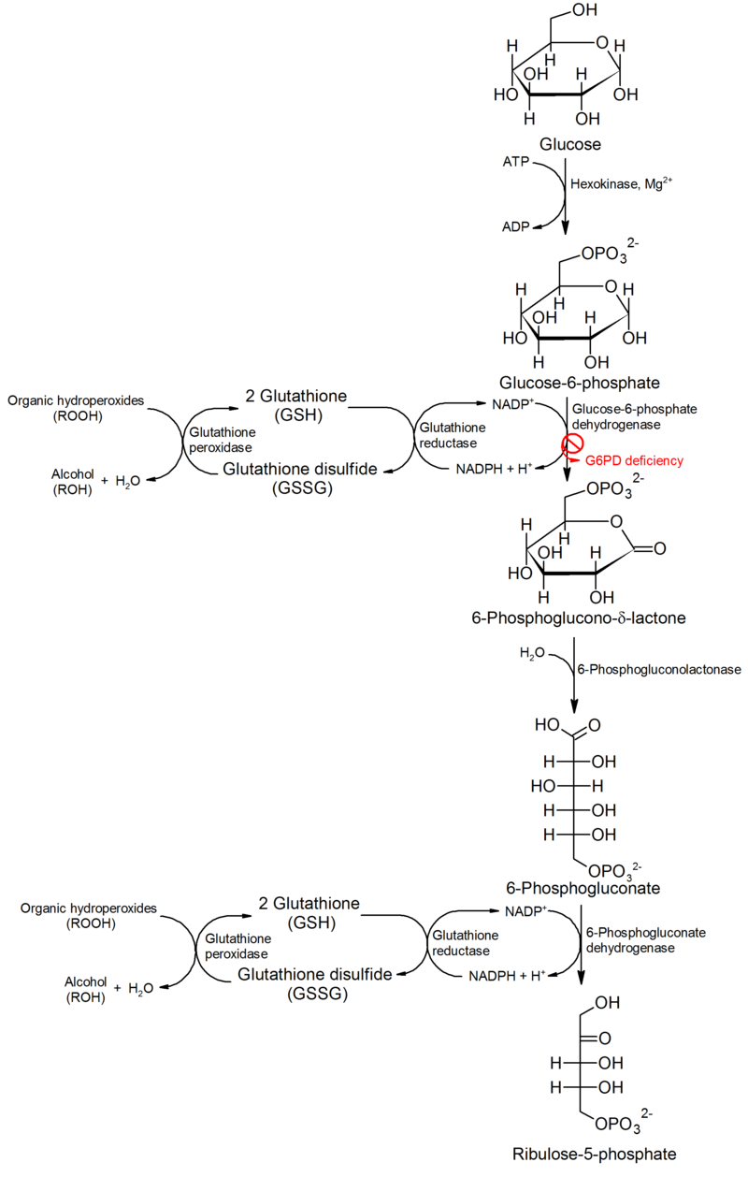

Slide 35
The genetic basis for the abnormal enzyme being heterogenous, most of the variations causing the enzyme to be unstable
Severe hemolysis occurs on the first administration and is maintained with continued administration
The Rx is sometimes called ‘Favism’ because it results from eating broad beans which contain an oxidant alkaloid

Slide 36
B- Glutathione reductase deficiency
This enzyme deficiency results in a deficiency in reduced GSH and hemolysis will then result from the effects of the oxidizing agents
In addition, warfarin and phenylbutazone have also been implicated
The defect has autosomal dominant inheritance

Slide 37
c- Methemoglobin reductase deficiency
methemoglobin reductase is a NADH-dependent enzyme that convertsmethemoglobin to hemoglobin. It contains FAD and catalyzes the reaction:
NADH + H⁺ + 2 ferricytochrome b₅ = NAD⁺ + 2 ferrocytochrome b₅
the most important enzyme in preventing the accumulation of MetHb in RBCs
Upon exposure to the oxidant drugs, more MetHb is formed but can be reduced rapidly
However, if there is MetHb reductase deficiency, this reduction is cannot be carried so efficiently and MetHb accumulates
MetHb causes impairment of oxygen delivery to tissues, this cause tissue hypoxemia
Treatment with a reducing agent methylene blue
Inheritance is autosomal recessive
Notes:
Methemoglobinemia (or methaemoglobinaemia) is a disorder characterized by the presence of a higher than normal level ofmethemoglobin (metHb, i.e., ferric [Fe³⁺] rather than ferrous [Fe²⁺] haemoglobin) in the blood. Methemoglobin is a form ofhemoglobin that contains ferric [Fe³⁺] iron and has a decreased ability to bind oxygen. However, the ferrous iron has an increased affinity for bound oxygen.^{[1]} The binding of oxygen to methemoglobin results in an increased affinity of oxygen to the three other heme sites (that are still ferrous) within the same tetrameric hemoglobin unit. This leads to an overall reduced ability of the red blood cell to release oxygen to tissues, with the associated oxygen–hemoglobin dissociation curve therefore shifted to the left. When methemoglobin concentration is elevated in red blood cells, tissue hypoxia can occur.

Slide 38
2- Porphyria
It constitutes a group of disorders of heme biosynthesis
Can present with acute symptoms or chronic effects
characterized by acute attacks of GI, neurologic/psychiatric, and CV symptoms
Attacks are more common in premenopausal adult women and in pregnancy

Slide 39
Symptoms of the acute hepatic porphyrias are often precipitated by administration of drugs such as barbiturates and ethanol, steroids or infections
This further decreases the amount of available heme, which, in turn, promotes the increased synthesis of ALA synthase

Slide 40
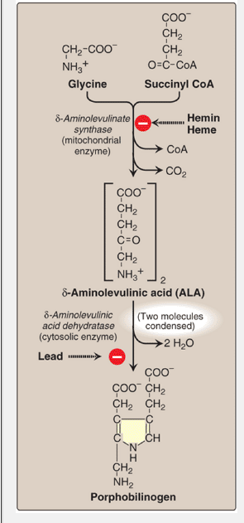

Slide 41
3- Malignant hyperthermia
A serious potentially fatal complication of general anesthesia with halothane and methoxyflurane
Inherited in autosomal dominant fashion
It is characterized by an acute rise in body temp to 40-41 C, muscle stiffness, tachycardia, sweating, cyanosis, and tachypnoea
Notes:
Malignant hyperthermia's inheritance is autosomal dominant with variable penetrance.^{[5]} The defect is typically located on the long arm of chromosome 19 (19q13.2^{[9]}) involving the ryanodine receptor.

Slide 42
Malignant hyperthermia
In a large proportion (50–70%) of cases, the propensity for malignant hyperthermia is due to a mutation of the ryanodine receptor (type 1), located on the sarcoplasmic reticulum(SR), the organelle within skeletal muscle cells that stores calcium. RYR1 opens in response to increases in intracellular Ca2+ level mediated by L-type calcium channels, thereby resulting in a drastic increase in intracellular calcium levels and muscle contraction.

Slide 43
The current treatment of choice is the intravenous administration of dantrolene, the only known antidote, discontinuation of triggering agents, and supportive therapy directed at correcting hyperthermia, acidosis, and organ dysfunction. Treatment must be instituted rapidly on clinical suspicion of the onset of malignant hyperthermia.

Slide 44
4- Insulin resistance
Insulin resistance is the decreased ability of target tissues, such as liver, adipose, and muscle, to respond properly to normal circulating concentrations of insulin.

Slide 45
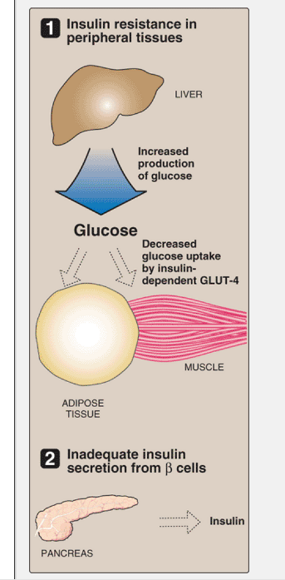

Slide 46
For example, insulin resistance is characterized by
uncontrolled hepatic glucose production, and
decreased glucose uptake by muscle and adipose tissue
Genetically determined resistance is rare
Attributed to mutations in the gene for insulin receptors
Some are dominant and some are recessive

Slide 47
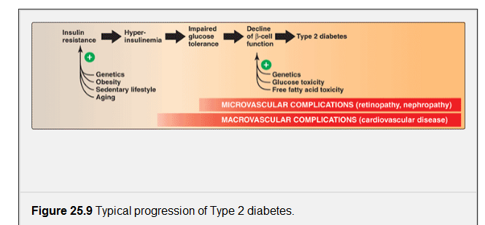

Slide 48
5- Arrhythmogenic effects of antiarrhythmic drugs
Polymorphous ventricular tachycardia (PVT) is a form of ventricular tachycardia in which there are multiple ventricular foci with the resultant QRS complexes varying in amplitude, axis and duration. The commonest cause of PVT is myocardial ischaemia.

Slide 49
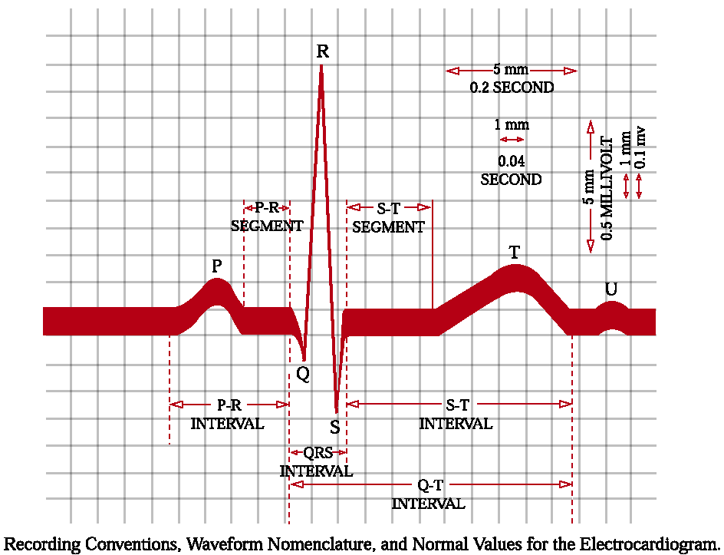
Normal features of the electrocardiogram

Slide 50
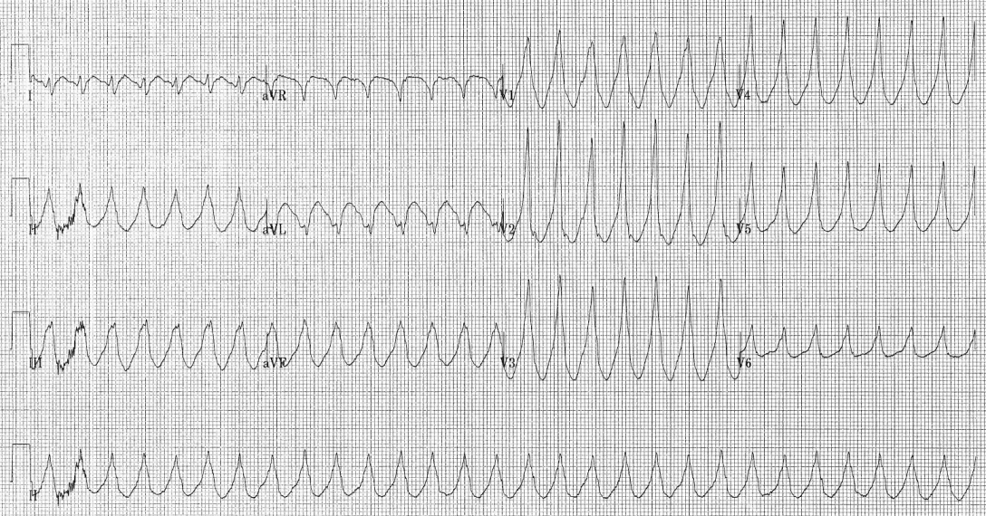

Slide 51
An autosomal dominant abnormality that has been attributed in some cases to a genetic abnormality of potassium channels.
It is possible that the susceptibility to drug induced Polymorphous ventricular tachycardia in some people without long QT interval might be related to polymorphism in potassium channel function
Genomic identification of such individuals could mark them out for avoidance of such drugs

Slide 52
6- resistance to drug effects
a) Vitamin D resistant rickets: There are 2 types
1- Familiar hypophosphatemic rickets
Due to impaired PO4 reabsorption in the kidney
2- Vitamin D dependency
Type I:Due to decreased 1α-hydroxylation of vitamin D in the kidney
It is therefore a pharmacokinetic abnormality
It respond to high dose of alfacalcidiol and calcitriol
Type II: a true pharmacodynamic abnormality with impaired tissue sensitivity to vitamin D and deceased receptor binding
Notes:
Calcitriol (INN), also called 1,25-dihydroxycholecalciferol or 1,25-dihydroxyvitamin D₃, is the hormonally active metabolite ofvitamin D with three hydroxyl groups (abbreviated 1,25-(OH)₂D₃ or simply 1,25(OH)₂D),^{[6]} It was first identified by Michael F. Holick in work published in 1971.^{[7]} Calcitriol increases the level of calcium (Ca²⁺) in the blood by increasing the uptake of calcium from thegut into the blood, and possibly increasing the release of calcium into the blood from bone.

Slide 53
b) Coumarin resistance
There is a wide range of dosage requirements for coumarin anticoagulants in general populations,
partly due to genetic variability in both metabolism of the drugs and the synthesis of clotting factors
There is also very rare type of resistance to the effect of these drugs in which 20 times the usual dosage may be required to produce satisfactory anticoagulant effect.

Slide 54
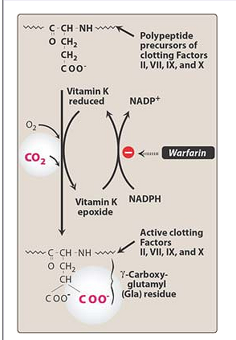
Mechanism of action of coumarins

Slide 55
In affected subjects both metabolism of the drug and the availability of vitamin K are normal
The mechanism may be resistance of the vitamin K epoxide reductase to inhibition mediated by warfarin.
The defect has autosomal dominant inheritance

Slide 56
Long term & withdrawal effects
Adaptive changes
Rebound and withdrawal phenomena

Slide 57
1- Adaptive Changes
Can occur in response to drug therapy
Ex.(1) Development of tolerance to the analgesic effect of opiates and increasing doses may be required to alleviate pain
However, tolerance does not occur to other effects of morphine (such as miosis and reduced GI motility)

Slide 58
physical dependence also occur with the narcotic analgesics
The precise mechanism of morphine tolerance is still not understood,
However, it is generally agreed that it is at the neuronal level

Slide 59
Ex.(2) Occurrence of tardive dyskinesia (abnormal movements) in some patients receiving long term neuroleptic drug therapy for schizophrenia
Because these abnormal movements come on late during drug use, they are known collectively as tardive dyskinesia
The face, mouth, and tongue are most commonly affected, causing stereotyped sucking of the lips, lateral jaw movements, and darting movements of the tongue.

Slide 60
The continuous long-term blockade of brain dopamine function with neuroleptic drugs leads to increased sensitivity to effect of dopamine in certain areas of the brain
So tardive dyskinesia is an expression to that increased sensitivity in extrapyramidal areas of the brain

Slide 61
2- Rebound & withdrawal syndrome
When adaptive changes occur during long-term drug therapy, sudden withdrawal of the drug can result in rebound reactions
Ex.(1) Typical syndrome that occur after the sudden withdrawal of narcotic analgesics or for alcohol
Sudden withdrawal of barbiturates can result in restlessness, sleeplessness, mental confusion, and convulsions
Sudden withdrawal of benzodiazepines induce anxiety features

Slide 62
Sudden withdrawal of antihypertensive drugs can result in rebound hypertension; this is particularly common with clonidine, which should always be withdrawn slowly
Sudden withdrawal of beta antagonists can result in rebound tachycardia, which can precipitate myocardial ischemia

Slide 63
In a separate category is the effect of the sudden withdrawal of corticosteroids
During the long term ttt with corticosteroids, there is interference with the normal feedback system involving the hypothalamus, pituitary gland, and adrenal gland
As a result, the hypothalamus and the pituitary become unable to react normally to the stimulus of low circulating corticosteroids conc.s and ACTH is not produced
The adrenal gland therefore atrophies
After sudden withdrawal of the corticosteroid, the syndrome of the acute adrenal insufficiency occurs

Slide 64
The extent to which this effect occurs depend on both 1) the daily dose and 2) the duration of ttt
The effect can be minimized to some extent by giving twice the usual dose but on alternate days
If a corticosteroid has to be given daily, in case if the therapeutic response is poor, suppression can be reduced by giving the dose in the morning
Withdrawal of corticosteroids should be very slow after long term administration, for example with prednisolone the daily dose should be reduced by only 1 mg at intervals of no less than a month

Slide 65
3- Other long-term effects
Chloroquin, which has a particular affinity to melanin, can accumulate in the corneal epithelium (causing keratopathy) and in the retina (causing pigmentary retinopathy and blindness)
The long-term adverse effect of amiodarone are caused by deposition in the tissues causing neuropathy, pulmonary alveolitis, liver damage, microdeposits in the cornea, and increased sensitivity of the skin to sunlight

Slide 66
4- Delayed Effects

Slide 67
4-Delayed effects causing ADRs
A simple example of a delayed ADRs is that of hypothyroidism occurring years after ttt of hyperthyroidism with radioactive iodine
This is a recognized and accepted risk of this form of ttt, whereas our other examples are adverse effects that are highly unacceptable

Slide 68
Delayed effects
Carcinogenesis
Adverse effects associated with reproduction

Slide 69
1- Carcinogenesis
It is seldom possible on clinical and pathological grounds, to distinguish a “naturally occurring” tumor from one produced by an identifiable chemical carcinogen
Much effort, time, and money, are expanded in testing drugs for carcinogenic potential,
There are three major mechanisms of carcinogenesis

Slide 70
a) Hormonal
A) The incidence of vaginal adenocarcinoma is clearly increased in the daughters of women who have taken stilbosterol during pregnancy for the ttt of threatened abortion
B) A great deal of attention has been paid to the carcinogenic potential of estrogens in hormone replacement therapy (HRT) and oral contraceptives.

Slide 71
For women taking HRT for more than 5 years, the increased risk of breast cancer is about 50%
For women aged 60-64, the risk increases to about 70%
These risks have to be balanced against the large beneficial effects of HRT on the symptoms of the menopause and on osteoporosis and cardiovascular diseases in postmenopausal women

Slide 72
Data on the benefit: risk ratio for HRT have not led to a boycott of HRT
There is now caution about prescribing HRT for a very long time, for example 10 years or more.

Slide 73
C) When oral contraceptives are concerned, there was a higher incidence of benign liver tumors in women taking estrogen formulations
Oral contraceptives might cause a very slightly increased risk of breast cancer in younger women

Slide 74
B- Gene Toxicity
This term is used to cloak the mystery of what happens when certain molecules bind to nuclear DNA and produce changes in gene expression, leading to abnormality in cell growth and the production of tumors
There are some examples of drug induced tumors which might fall into this class

Slide 75
1- The increased risk of bladder cancer in patients taking long term cyclophosphamide
2- carcinomas of the renal pelvis associated with phenacetin abuse
3- the occurrence of leukemia in patients receiving alkylating agents such as cyclophosphamide and chlorambucil

Slide 76
C) Suppression of Immune Responses
Patients taking immunosuppressive drugs such as azathioprine with corticosteroids, have a greatly increased risk of developing lymphomas
In immunosuppressed patients, there is also an increase risk of cancers of the liver, biliary tree, and bladder, bronchial adenocarcinoma

Slide 77
There is a relationship between the occurrence of lymphoma and long-term use of phenytoin.
At present, this effect does not influence the prescribing of phenytoin for ttt of epilepsy.

Slide 78
a) Impaired Fertility
While impaired fertility in women is a desired effect of oral contraceptives, it may unwanted effect of other drugs
E.x. cytotoxic drugs can cause female infertility through ovarian failure with amenorrhea

Slide 79
Male fertility can be reduced by impairment of spermatozoal production or function and can be either reversible or irreversible
i) Reversible impairment can be caused by MAO inhibitors and antimalarial agents
ii) Irreversible impairment can be caused by cytotoxic drugs such as alkylating agents (cyclophosphamide and chlorambucil )

Slide 80
b) Teratogenesis:
Teratogenesis occur when a drug taken during the early stages of pregnancy causes a developmental abnormality in a fetus
E.g. Mongolism (Down’s syndrome)

Slide 81
C) Adverse Effects on The Fetus During the Later Stages of Pregnancy
Sometimes a drug taken by the mother during the later stages of pregnancy causes adverse effects in the fetus

Slide 82
D D) Adverse Reactions to Drugs in Breast Milk
Certain drugs are excreted sufficiently in breast milk to affect the infants, while others are known to be safe.
E.g. metronidazole
E.g. Some antibiotics

Slide 83
DRUG USE AND PREGNANCY
The use of any medication—prescription or nonprescription—carries a risk of causing birth defects in the developing fetus.
Drugs administered to pregnant women, particularly during the first trimester, may cause teratogenic effects.
A teratogen is any substance that causes abnormal development of the
fetus leading to a severely deformed fetus.
Drugs are one type of teratogen.

Slide 84
In an effort to prevent teratogenic effects, the FDA has established five categories suggesting the potential of a drug for causing birth defects.
Information regarding the pregnancy category of a specific drug is found in reliable drug literature, such as the inserts accompanying drugs and approved drug references.
In general, most drugs are contraindicated during pregnancy or lactation unless the potential benefits of taking the drug outweigh the risks to the fetus or the infant.

Slide 85
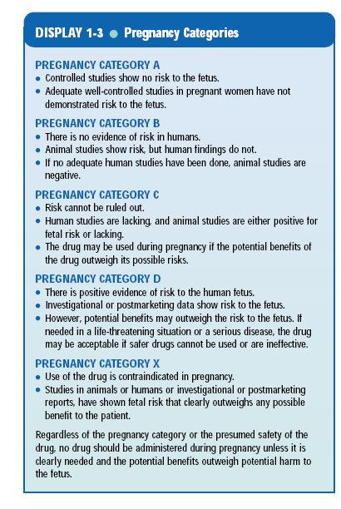

Slide 86
Reporting of ADRs
Medwatch– Serious ADRs
– Resulting in death, life-threatening, initial or
prolonged hospitalization, disability, congenital anomaly, permanent impairment/damage
Medications
Medical Devices
Special Nutritional Products
Other products regulated by the FDA

Slide 87
The Medication Use System
High-Level Portrayal of a Medication Use System
Selection & Procuring
Establish formulary
Prescribing
Assess patient; determine need for drug therapy; select & order drug
Preparing & Dispensing
Purchase & store drug; review & confirm order; distribute to patient location
Administering
Review dispensed drug order; assess patient & administer
Monitoring
Assess patient response to drug; report reactions & errors
Clinician & administrators
Physician/ prescriber
All practitioners, plus patient &/or family
Pharmacist
Nurse/other health professionals
Joint Commission. 1998

Slide 88
Causality Assessment– Strength of Association
Dechallenge
– Stop medication  ADR stops  Decreases
or gets better
Rechallenge-
– Start medication  ADR reoccurs
Temporal Sequence-
– Signs/symptoms do not start prior to
administration

Slide 89
Clinical case
Mrs. Smith is a 55-year-old, white woman who has type 2 diabetes, hypertension, hypercholesterolemia, and arthritis. She has been admitted to the hospital to bring her diabetes under control and to be worked up for possible bladder cancer. Yesterday, she was started on a different drug for her diabetes. Today, she is complaining of significantly increased pain in her knee joints, and there is some redness, tenderness, and swelling in her knees. The medical intern thinks that this is a worsening of her arthritis. The medical resident thinks that this is a new medical problem. The pharmacy resident thinks that it is an adverse drug reaction (ADR). Who is right?

Slide 90
Data collection
Patients demographic data
Presenting complaints
Past medication history
Drug therapy details including over OTC drugs
Current medications ( timing)
Medication on admission
Lab data.

Slide 91
Table. The Naranjo Algorithm.
Question | Yes | No | Not Know
1. Are there previous conclusive reports on this reaction? | +1 | 0 | 0
2. Did the adverse event appear after the suspected drug was administered? | +2 | -1 | 0
3. Did the adverse reaction improve when the drug was discontinued or a specific antagonist was administered? | +1 | 0 | 0
4. Did the adverse reaction reappear when the drug was readministered? | +2 | -1 | 0
5. Are there alternative causes (other than the drug) that could on their own have caused the reaction? | -1 | +2 | 0
6. Did the reaction reappear when a placebo was given? | -1 | +1 | 0
7. Was the drug detected in the blood (or other fluids) in concentrations known to be toxic? | +1 | 0 | 0
8. Was the reaction more severe when the dose was increased, or less severe when the dose was decreased? | +1 | 0 | 0
9. Did the patient have a similar reaction to the same or similar drugs in any previous exposure? | +1 | 0 | 0
10. Was the adverse event confirmed by any objective evidence? | +1 | 0 | 0

Slide 92
Naranjo scores of 9 or 10 indicate that an event was "definitely" an ADR; scores of 5-8 rate the likelihood as "probable"; scores of 1-4 are "possible"; and scores of less than 1 are "doubtful."

Slide 93


Slide 94
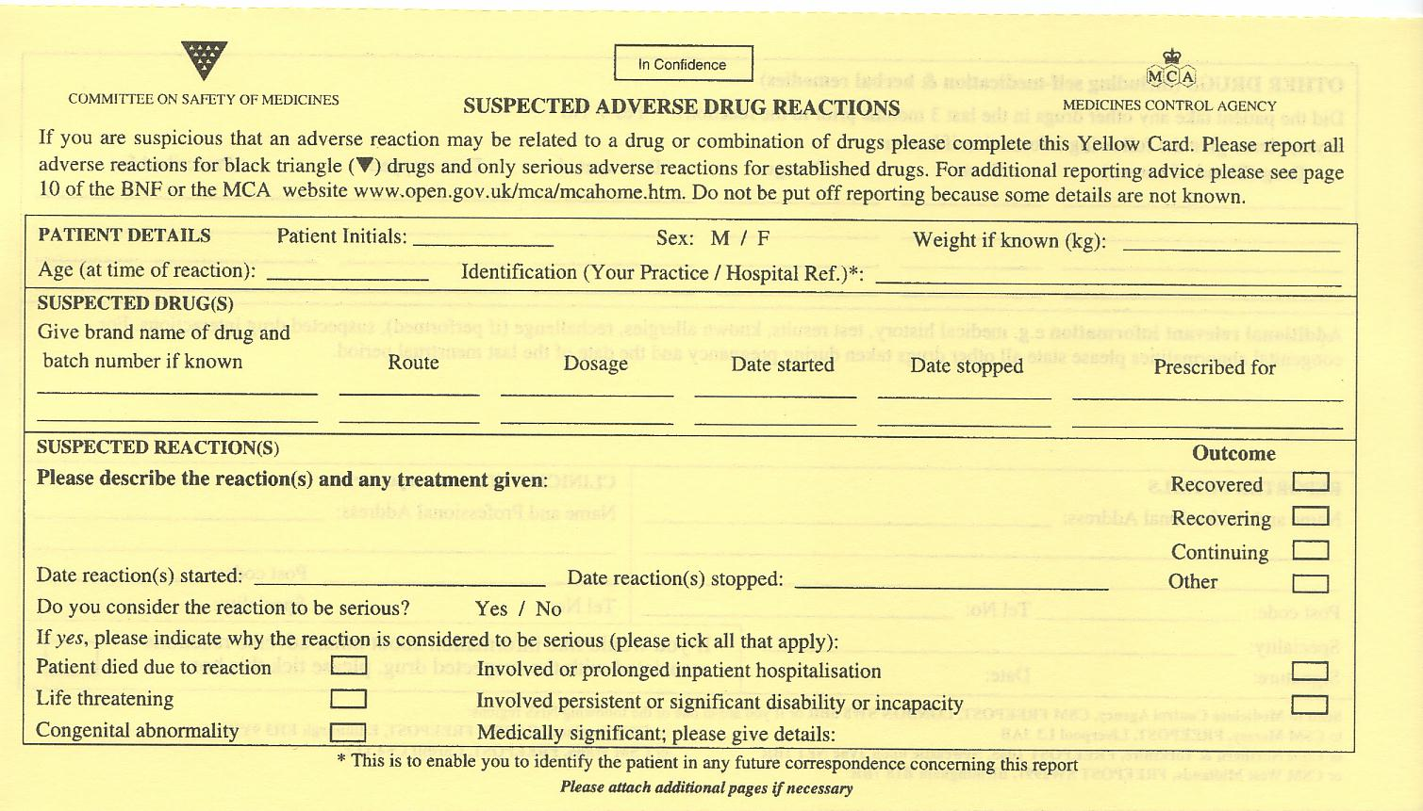

Slide 95
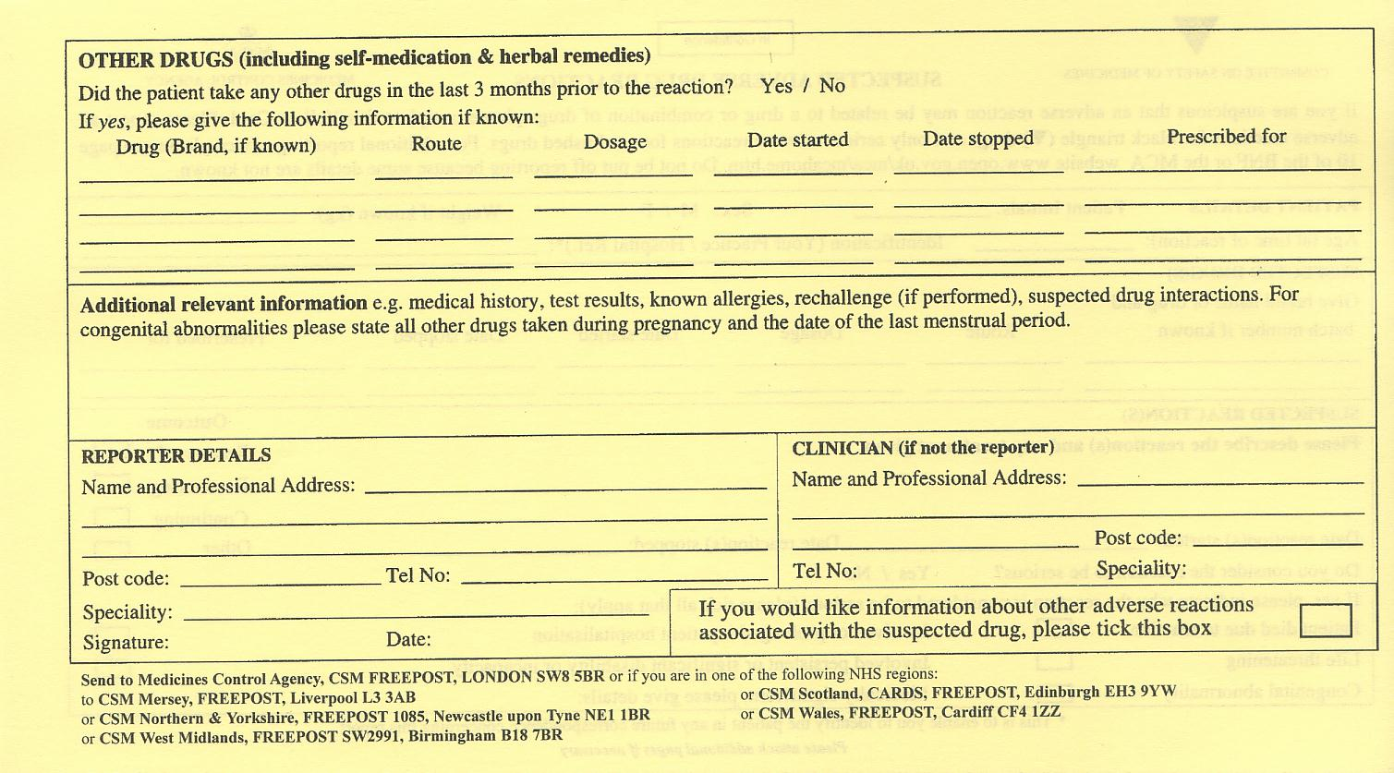

Slide 96
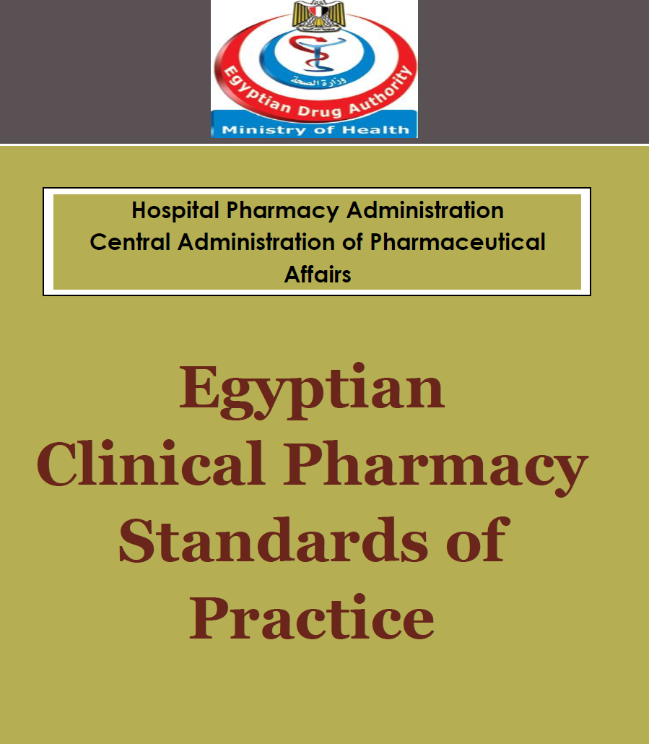

Slide 97
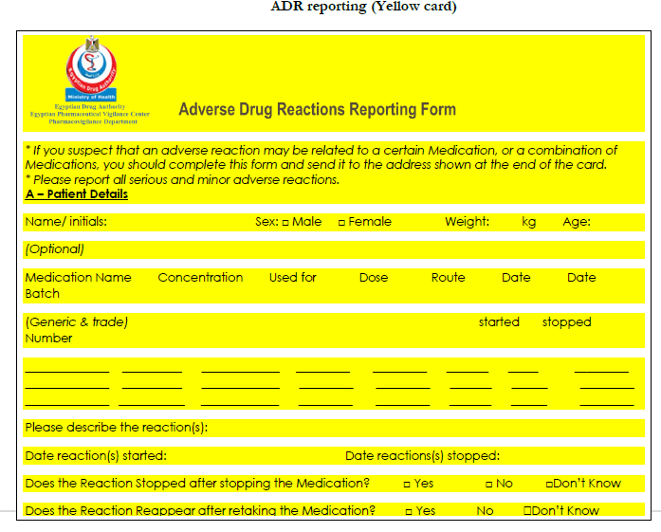

Slide 98
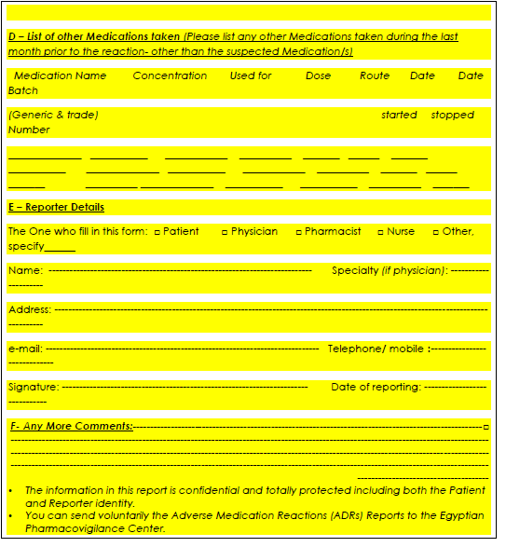

Slide 99
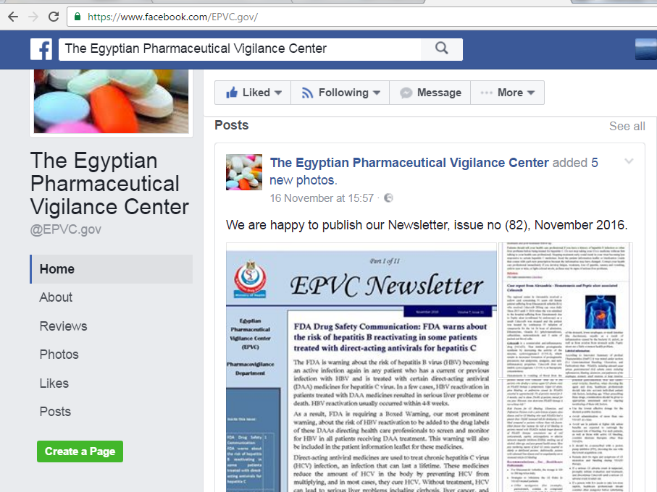

Slide 100
Detection & Monitoring of ADRs
Case reports
Cohort studies
Case-control studies
Spontaneous reporting schemes

